Slide 1

Task 4 - Halloween Candy Data
Tara Durham

Slide 2
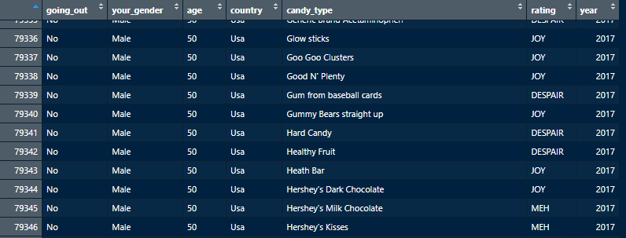
Project Preparation
reshape
What data is relevant to answer the questions?
Data review and conceptualisation:
merge
join
What is the total number of candy ratings given across the three years?
What was the average age of people who are going out trick or treating?
What was the average age of people who are not going trick or treating?
For each of joy, despair and meh, which candy bar received the most of these ratings?
How many people rated Starburst as despair?
What was the most popular candy bar by this rating system for each gender in the dataset ?
What was the most popular candy bar in each year?
What was the most popular candy bar by this rating for people in US, Canada, UK, and all other countries?
clean
pivot
rbind.fill
2

Slide 3
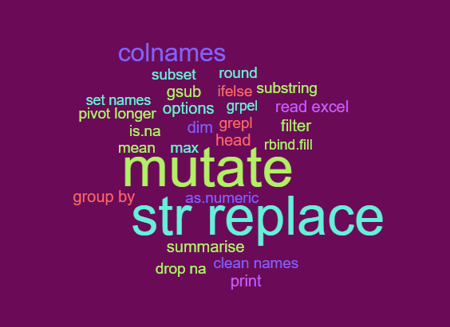

Cleaning Steps & Considerations
meh, country & gender 2015 survey
removing NAs
group_by and plyr problems

Slide 4
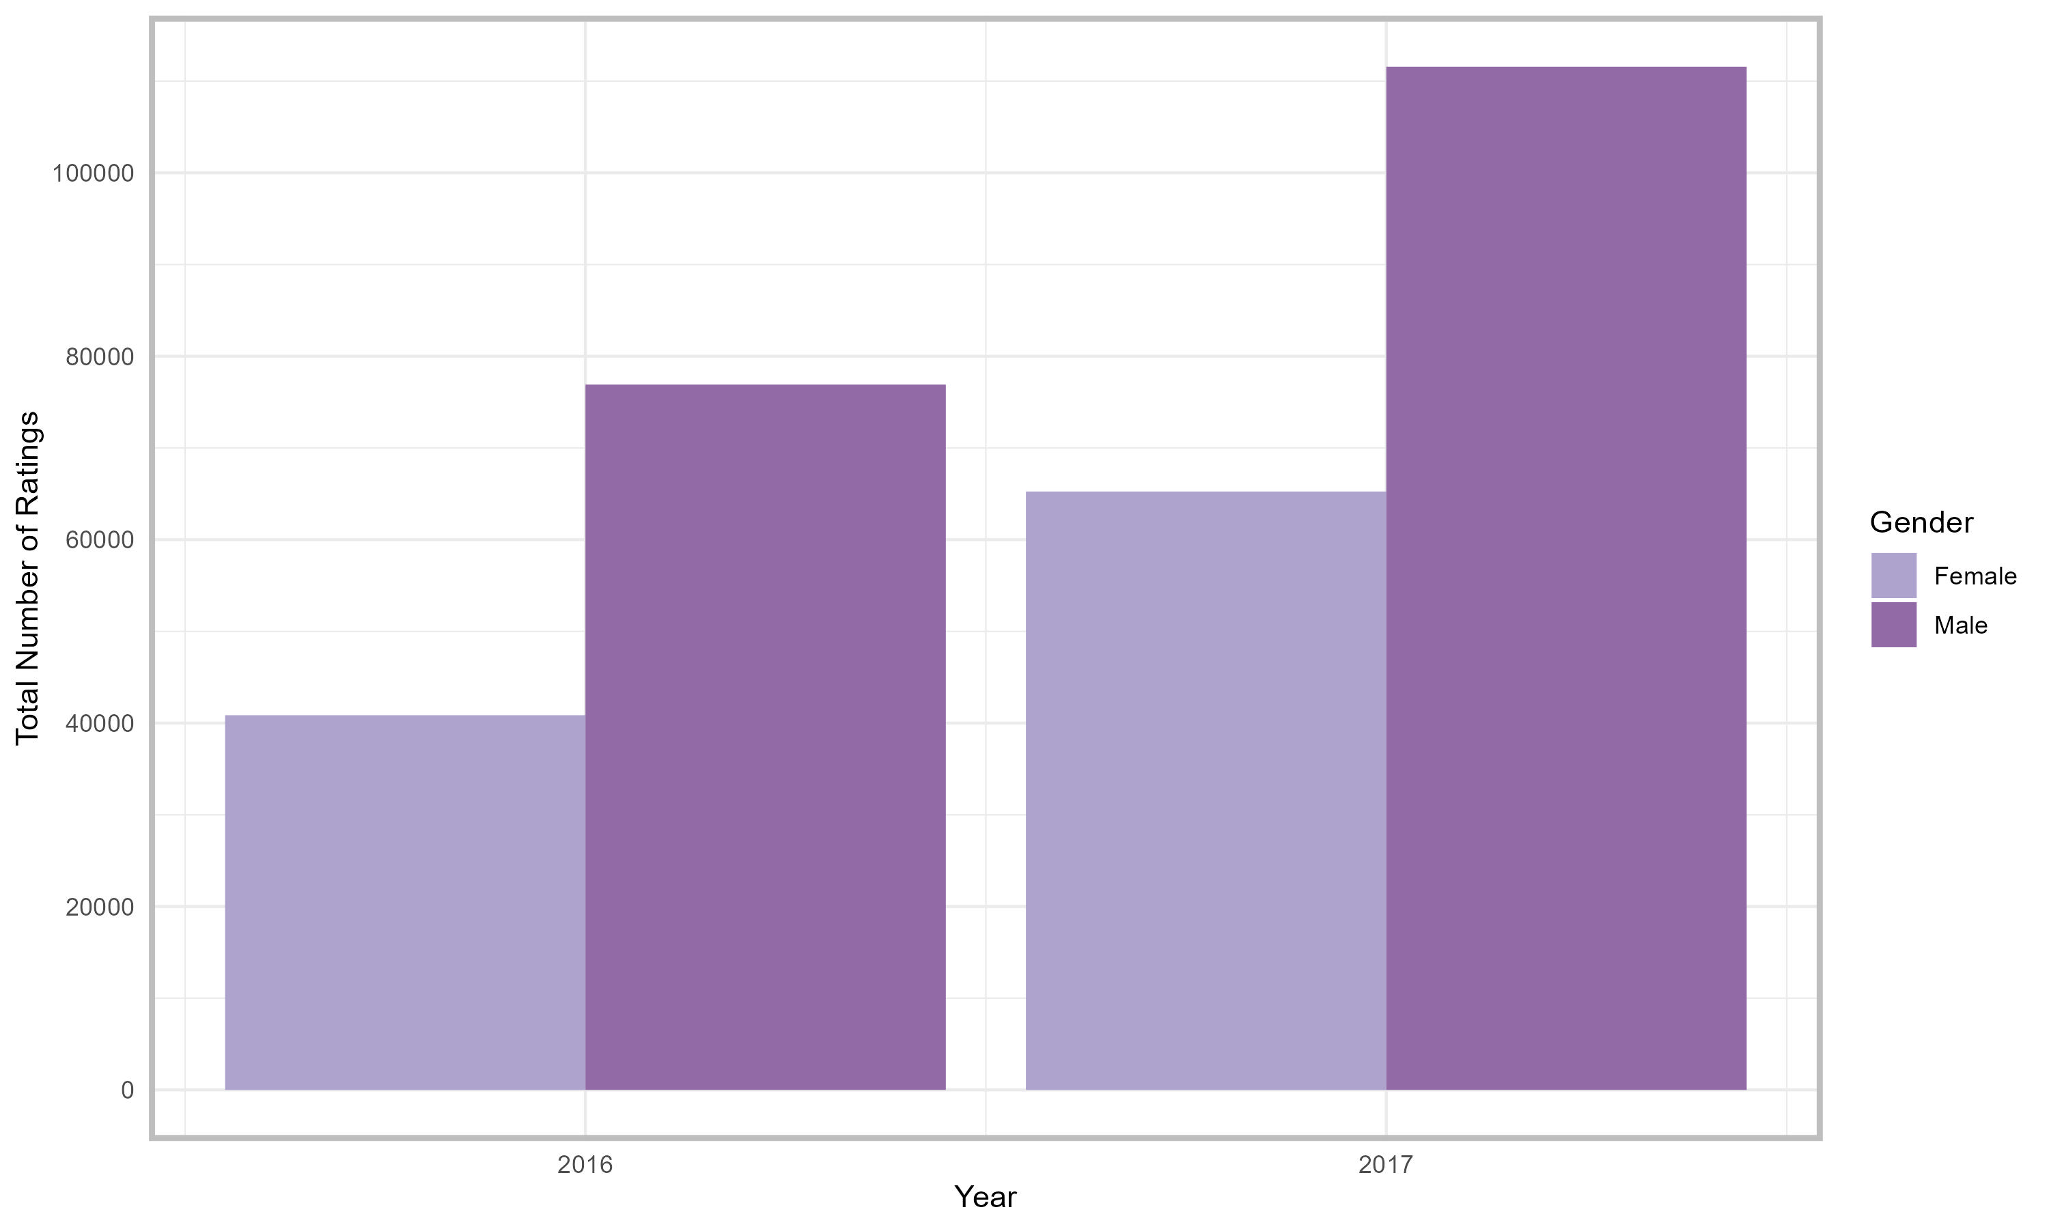
Visualisations & Findings

